Slide 1
Fresh Baked Ideas:
10 Fresh Marketing Ideas
Colleen Jolly, Mach Media

Slide 2
Goodies!
Notes:
Goodies – presume you have a website and some social media but you’re prob not using them too much. We’ll share some tips – some are easy and free – a few are a bit more complicated. All are things you can DIY starting now! Cameron, Kailtlyn and I are your new neighbors and if y’all have any questions about this stuff just let us know!

Slide 3
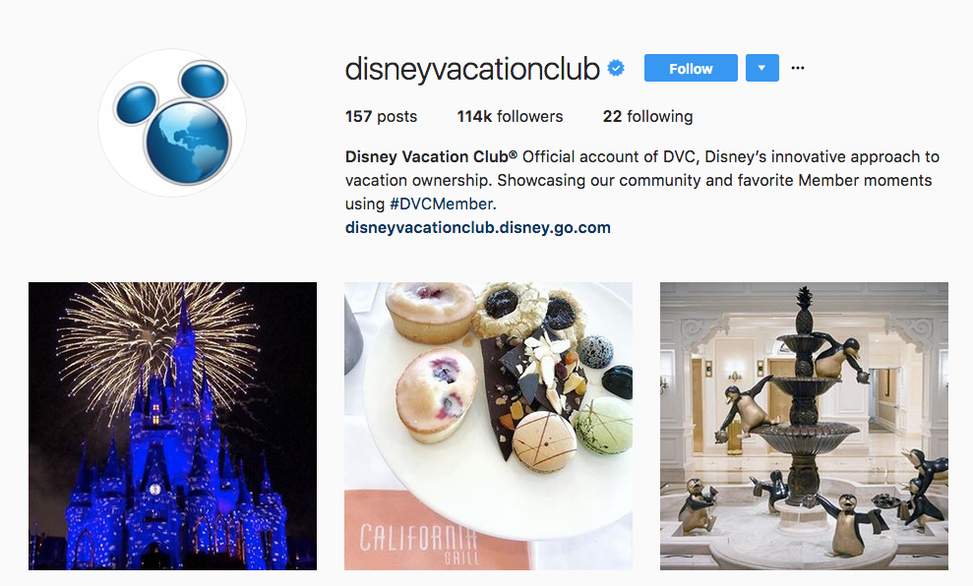
User Generated Content
People like you and your service/product
Encourage customers to post photos/video/stories
Creates community
100% free!!
Tool: any social
Notes:
People like you and your service/product.
Encourage customers to post photos/video/stories on social media using your product or service and give them a hashtag in your bio that allows you to repost customers (“Use #ilovedogs to be featured”). This creates community and more people are likely to buy something their friends or someone they trust recommends. It’s also 100% free.

Slide 4
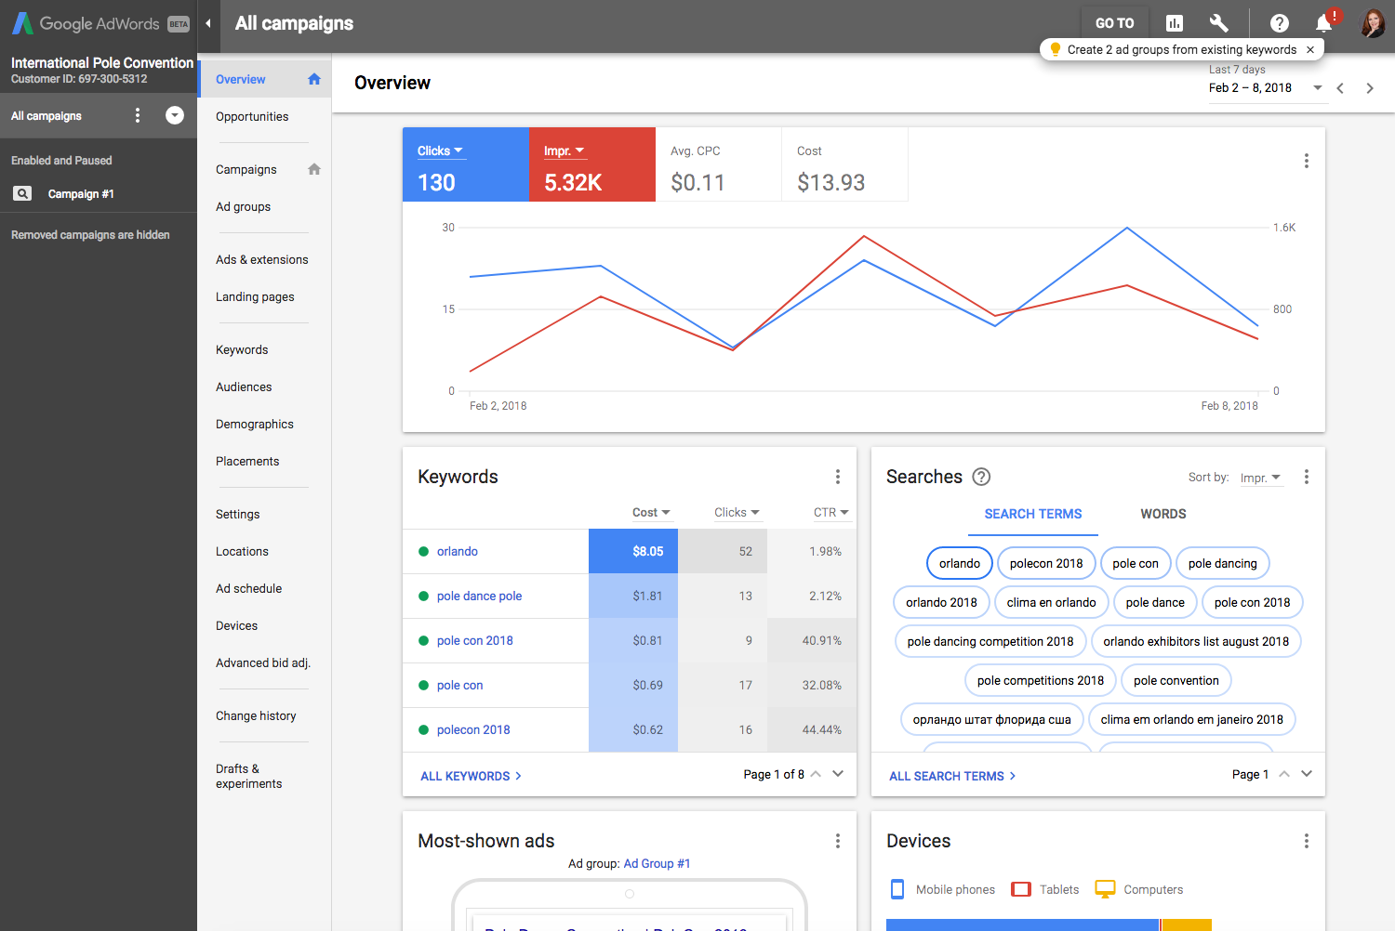
Google Ad Words
Best cents-on-the-dollar you’ll spend!
Works with Google Analytics
Runs basically on autopilot
Tool: Google Ad Words and Google Analytics
Notes:
it’s the best cents-on-the-dollar you’ll spend! Make sure you’ve got your Google Analytics set up and track what words drive people to your website by also reviewing competitors ad words. Google does much of the hard work for you and offers suggestions through regular automated check-ups that you can implement or ignore.

Slide 5
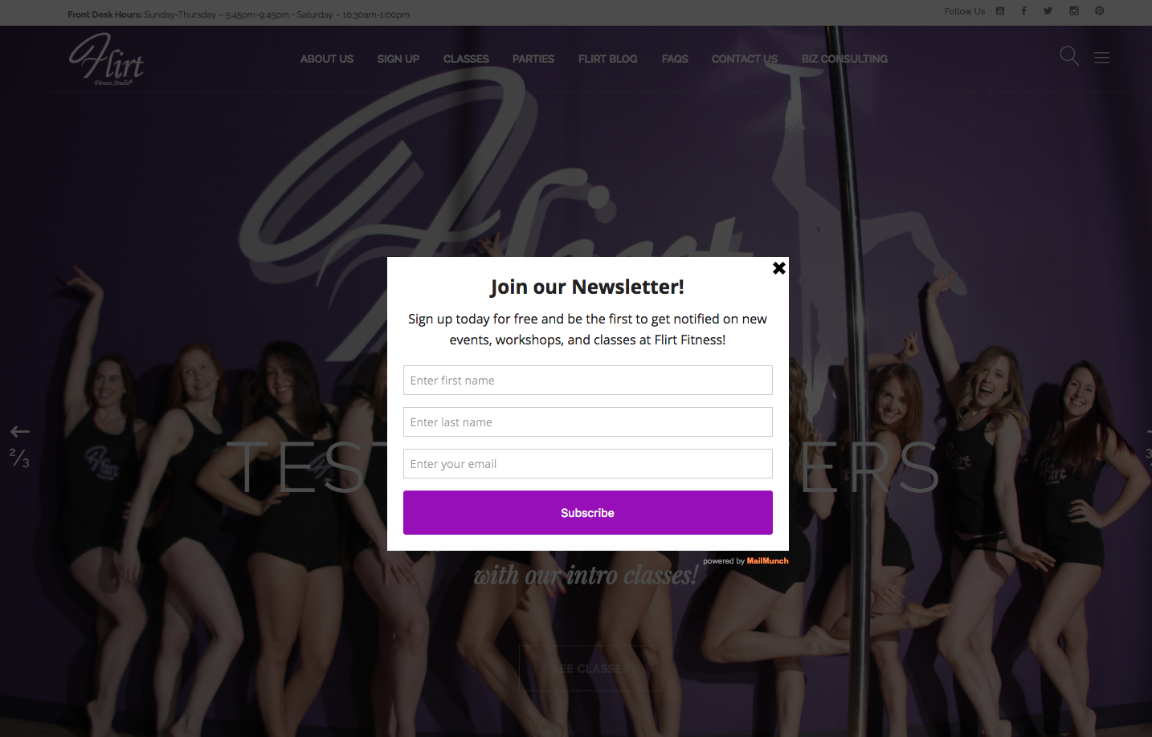
Website Pop-Up
Make a compelling reason: a free study, white paper or trial of your service
Free* with email service
Tool: MailMunch others integrate with ConstantContact, MailChimp
Notes:
for newsletter or for a download to capture email addresses. While some people say they are annoying, they are also super effective (more so than a sidebar option) for gathering actual contact information of potential clients. Make a compelling reason for them to pony up that info like a free study, white paper or trial of your service.

Slide 6
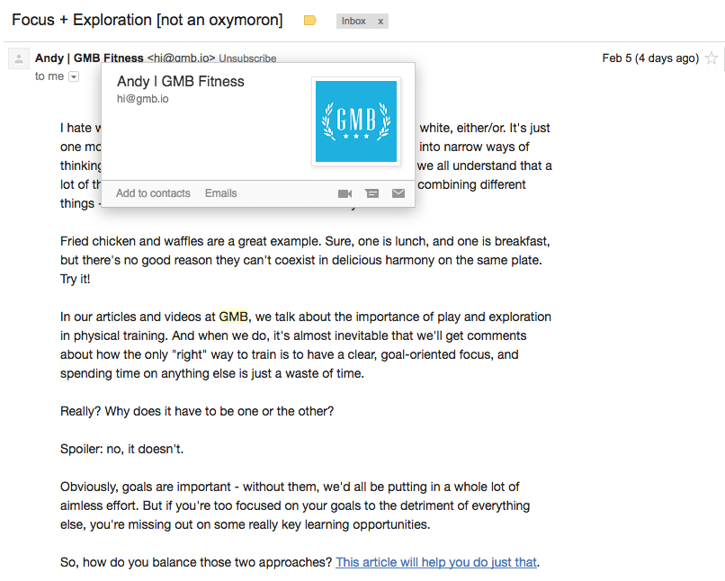
Email Marketing
Still the cheapest way to directly contact customers and leads
Catchy subject lines and track click throughs
Try different formats (text only/text + images)
Tool: ConstantContact, MailChimp, MyEmma
Notes:
this doesn’t sound fresh! I know but -- email marketing is still the cheapest way to directly contact people that have bought from you or are likely to buy. Keep your emails interesting with catchy subject lines and track what information actually gets click throughs to provide more of those. Set a rule for how often you email and stick to it. People should look forward to your emails, not automatically delete them.

Slide 7
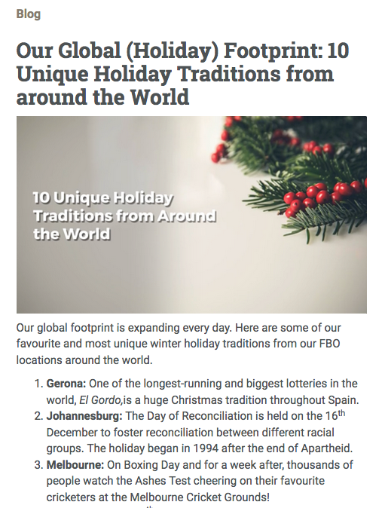
Recycle/Repackage Content
Cut it up and repost on social media
Make a social media meme that is easily shareable
Recycle/repurpose and create micro-content
Original Blog Content
Social Media Meme
Tool: Canva.com Tyoprama, Studio -- FREE!
Notes:
wrote an awesome blog post a few years ago? Cut it up and repost on social media. Made a video that has some great statistics? Make a social media meme that is easily shareable. You don’t have to create new content all the time – recycle/repurpose and create micro-content: bite sized pieces of information appropriate for sharing out of awesome content you already have.

Slide 8
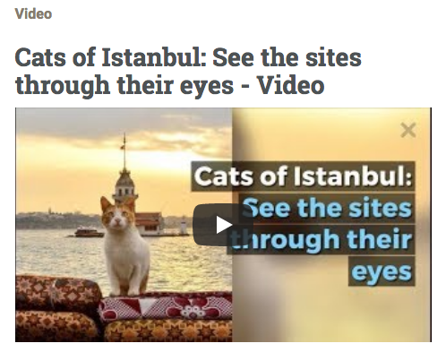
Make More Video
Attention spans are getting shorter and shorter
Use video to communicate
https://youtu.be/bW1QcwyvYN4
Tool: Lumen5 – FREE!

Slide 9
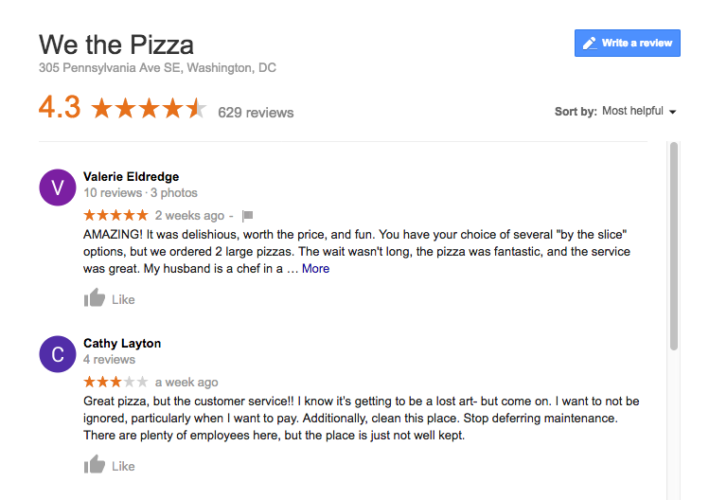
Review Sites
Yelp or Google + others for your industry
Make sure your info is correct and check out what people are saying
Frame future marketing efforts
Tool: Yelp, Google, RateMyProfessor, others
Notes:
Yelp or Google, there are others for your industry. Make sure your info is correct (most offer a free ability to claim your listing) and check out what people are saying. This can help you frame future marketing efforts and also uncover great things to highlight or things to fix in your operations

Slide 10
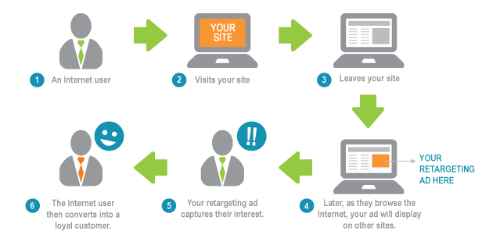
Retargeting
Tricky to DIY
Effective and unobtrusive
Tool: Retargeting.com
Notes:
a bit trickier to DIY. This is why you go to a website and then you keep seeing ads for that website everywhere you go – it’s because they installed a cookie in your browser. Effective and unobtrusive, many companies are using this

Slide 11
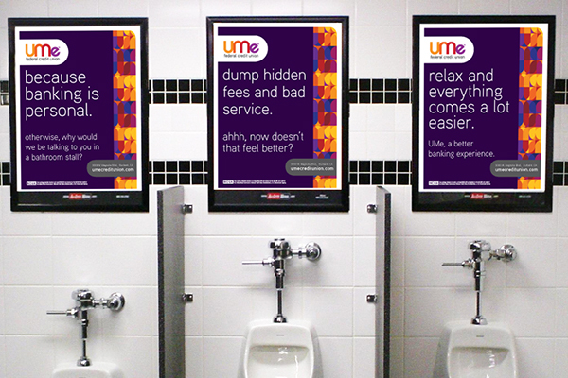
Make it Local
Where do your customers go? IRL and online?
Find a way to reach them in a targeted way
Tool: Any social for research
Notes:
where do your customers go? IRL and online? Find a way to reach them there in a targeted way rather than blasting your content into the void. You’d be surprised how many fliers on the back of bathroom stalls work for generating leads!

Slide 12
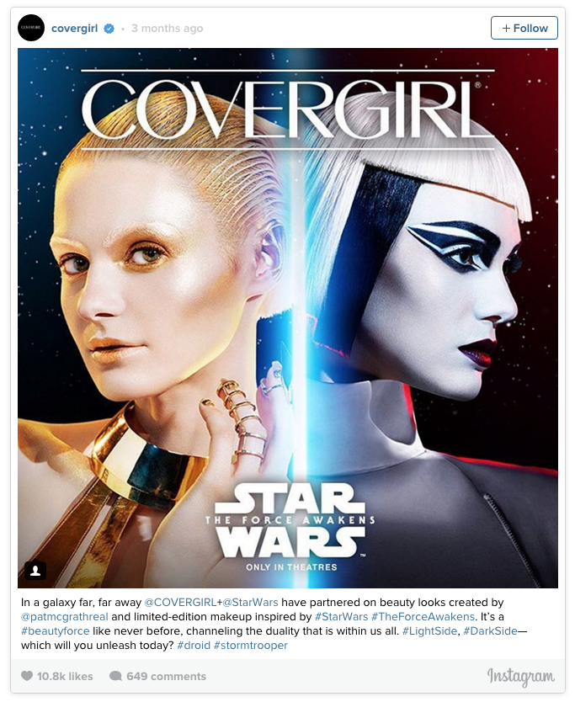
Develop Partnerships
Find other companies that offer complimentary services/products
Partner digitally and share blog posts and cross post
Tool: Any social/online for research
Notes:
find other companies that offer complimentary services/products and you’ve immediately doubled your sales force. Can’t find someone in person? Partner digitally and share blog posts and cross post each other’s social with a formal referral agreement or an informal handshake.

Slide 13
Colleen Jolly
Senior Consultant
+1 202 210 6982
colleen.jolly@machmediagroup.com
www.machmedia.be

